Slide 1
What’s new since 2012
Results from NACP indicate that better phenology is needed.
Burgeoning of both National phenology Networks and web/tower cameras
In the US: National Climate Assessment (and NASA is looking to contribute!)
Advances in active sensors and LSP
Notes:
Burgeoning

Slide 2
What’s the same since 2012
No dedicated person (or funding) to move the effort forward.
Notes:
Burgeoning

Slide 3
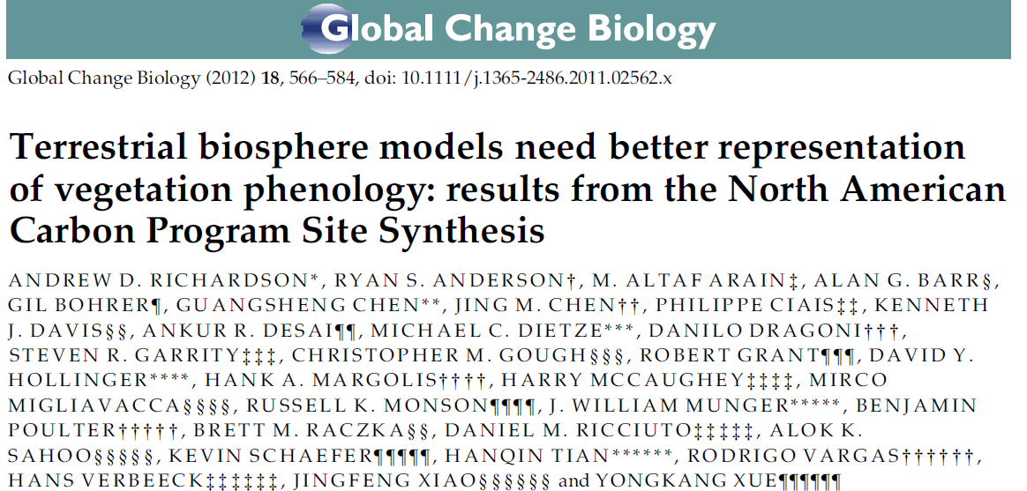

Slide 4
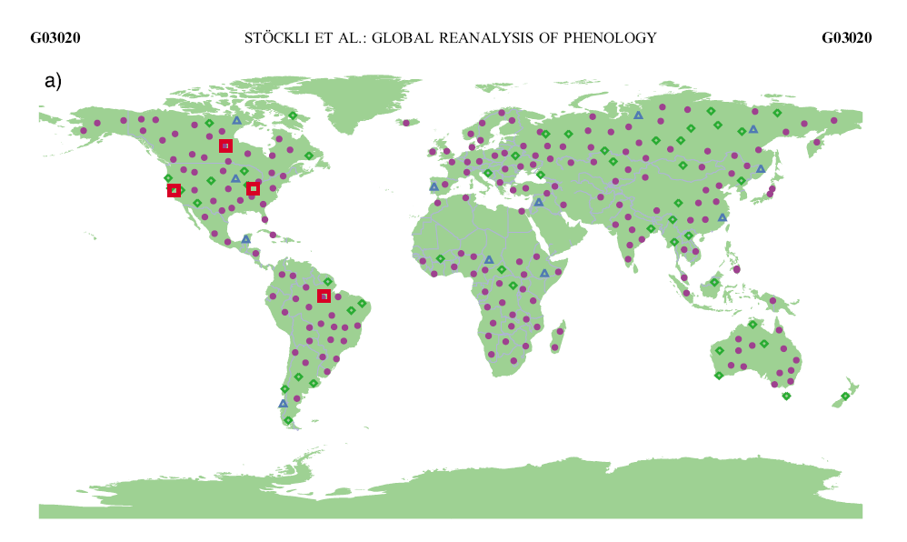

Slide 5
Site selection recommendations
Consider two types of sites:
Type A: Ground observations and multiple resolution scaling analysis
Type B: Pheno cams with network observations
Prioritize site:
Global representation based on international collaboration and evaluating a range of biomes
Dedicated research effort using a phenology product for that site
Availability of, and capacity to analyze, a time series of deca-resolution imagery
Overlay web cam locations on Bill Hargrove’s phenocluster
Query all phenology network data within that cluster
Focus on addressing the question of seasonality of plant photosynthesis

Slide 6
Issues with using phenology network observations (White et al.2009)
variable temporal and spatial coverage within and among networks;
species monitored may or may not represent general landscape phenology – the classical point vs. pixel problem in remote sensing assessments in which a single point observation may or may not represent the overall pixel characteristics;
different measurement protocols among networks;
unknown measurement accuracy and errors in data entry;
different phenological stages measured (e.g. leaf vs. bloom phenology and differences in how each stage is defined).

Slide 7
Validation issues (Tan et al. 2011)
“However, validating phenology metrics derived from moderate or coarse resolution satellite data product is difficult due to the scale-mismatch with ground observations as well as vegetation heterogeneity. Vegetation is rarely uniform at the scale of MODIS resolution, while field observations normally indentify the timing of the budburst or flowering for one or a few plants at each validation site. The relationship between observed phenology events and the average vegetation phenology status over the spatial coverage of the MODIS pixel are usually not quantitatively assessed.”

Slide 8
Second season issues

Slide 9
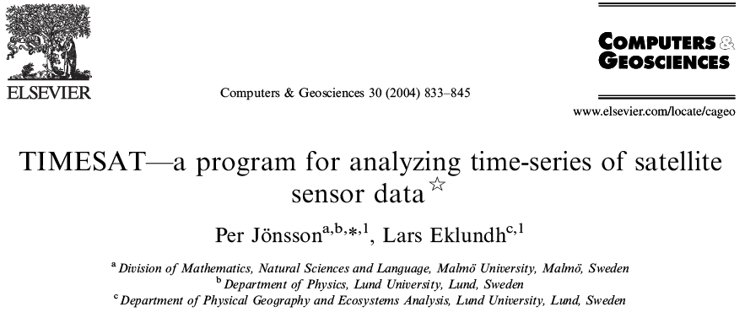
Beginning of season
End of season
Length of season
Base value
Peak time
Peak value
Amplitude
Left derivative
Right derivative
Integral over season - absolute
Integral over season - scaled
Maximum value
Minimum value
Mean value
Root Mean Square Error
Notes:
TIMESAT derives 11 phenology parameters, or metrics, for up to two separate seasons each year. The phenology parameters are 1) time for the start of the season, which is when the left edge of the fitted function has increased to a user-defined level, often 20% of the seasonal amplitude, 2) time for the end of the season, or when the right edge has decreased to a user-defined level, 3) length of the season, 4) base level, or the average of left and right minimum values, 5) time for the middle of the season, 6) peak value of the fitted function, 7) seasonal amplitude, or the difference between the peak value and base level, 8) left slope, or rate of increase at the beginning of the season, 9) right slope, or the rate of decrease at the end of the season, 10) large seasonal integral, from season start to season end, and 11) small seasonal integral, relative to the base level. Figure 3 displays these phenology parameters.

Slide 10
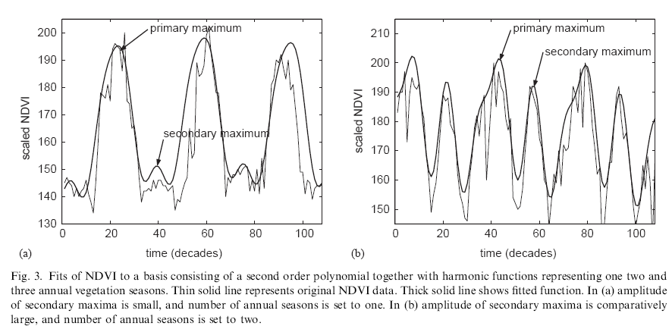
Timesat 2nd season
“If the amplitude of the secondary maxima
exceeds a certain fraction of the amplitude of the
primary maxima we have two annual seasons.”
Jonsson and Eklundh, 2004

Slide 11
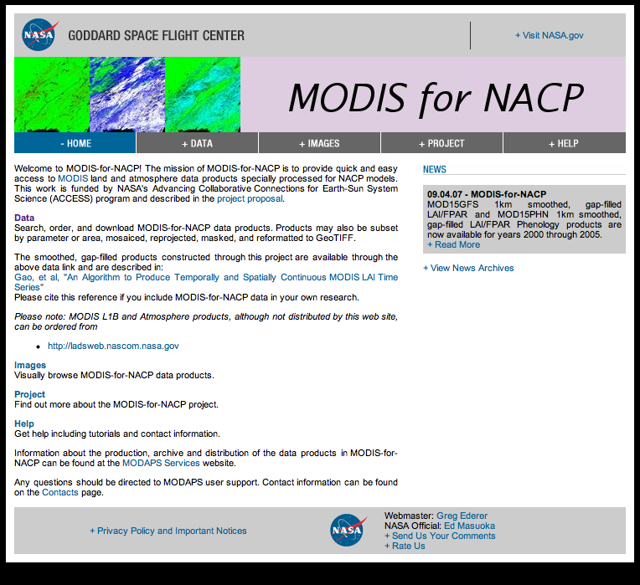
MODIS for NACP project: Helping NACP investigators better utilize MODIS data products
Offering original and smooth/gap-filled LAI, FPAR, EVI & NDVI products with the following data services:
Subset by geographic area
Subset by data layer
Reproject
Mosaic
Re-format (to GeoTIFF).
Phenology Product User Guide, Tan et al http://accweb.nascom.nasa.gov/project/docs/User_guide_PHN.pdf.

Slide 12
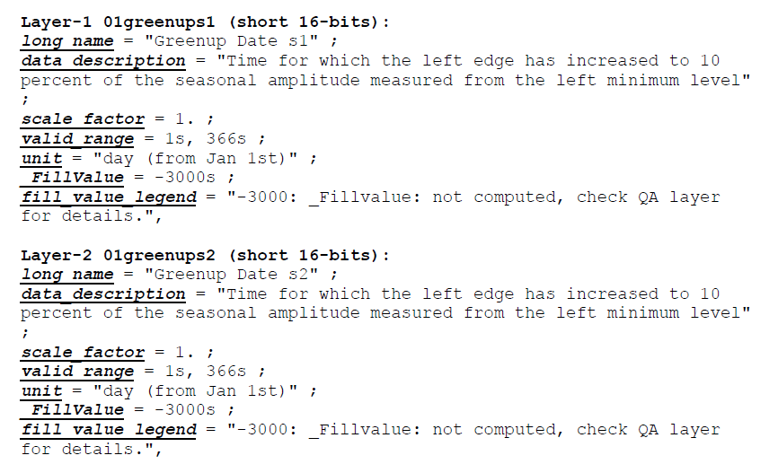
MODIS for NACP project: Helping NACP investigators better utilize MODIS data products
Phenology Product User Guide, Tan et al http://accweb.nascom.nasa.gov/project/docs/User_guide_PHN.pdf.

Slide 13
Notes:
while the land area with two seasons for any given year is only about 1% of the total, for specific land management units the amount of area impacted by these issues can be significant. To demonstrate this we consider U.S. National Park Service and U.S. Fish and Wildlife Service land management units and show that roughly 1/3 of these units have at least some areas with two seasons. Furthermore we found 52 management units with more than 10% of their total area showing a 2nd season.

Slide 14
Southern Brazil

Slide 15
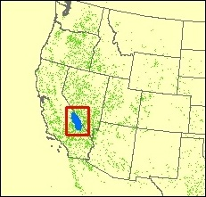
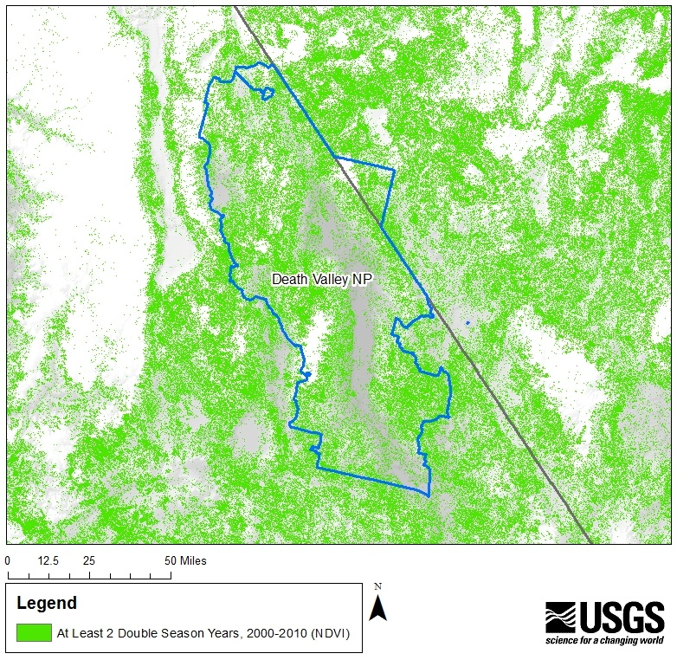
Area enlarged, right.
Implications for:
-Season Length
-Maximum Peak Values
-Green Up / Brown Down Dates
44% of Death Valley National Park had 2 or More Double-Season Years Between 2000 and 2010

Slide 16
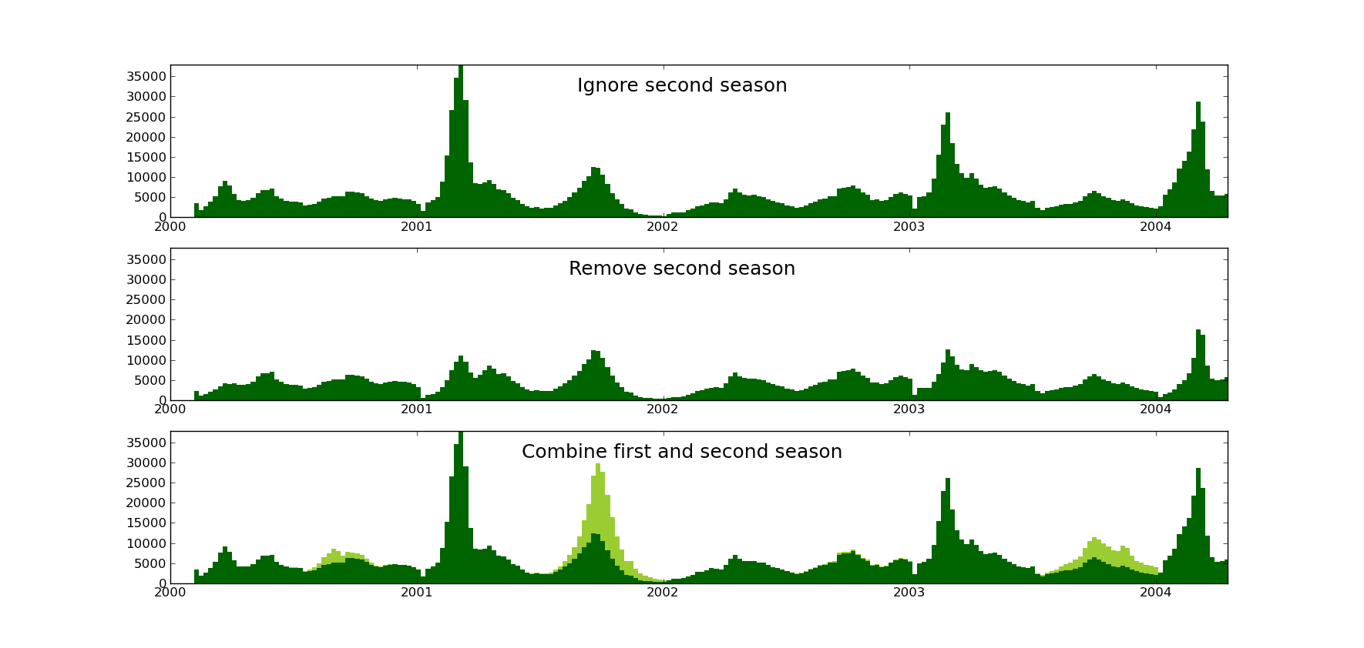

Slide 18
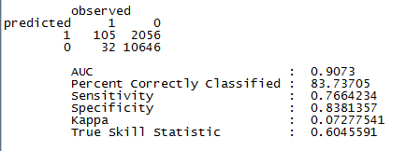
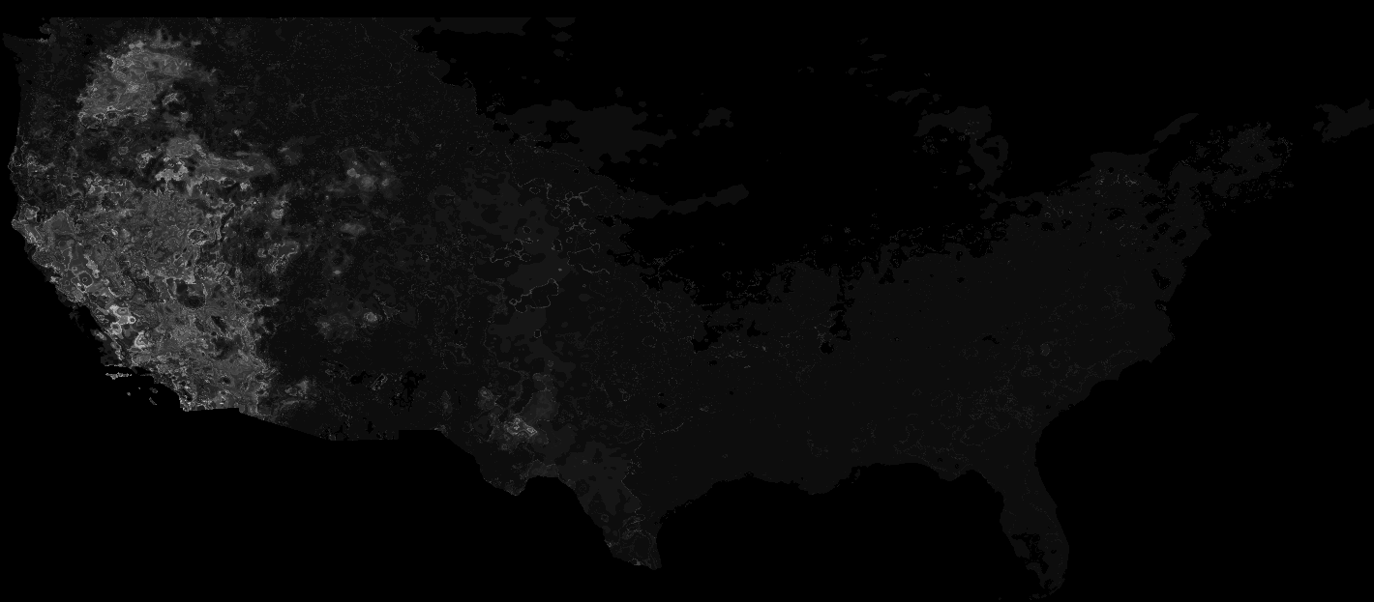
2001 second season predicted with climate: Isothermality, precip in warmest quarter
Notes:
Mid range of bioclim 3 and lowest range of bioclim 18 are more likely to have second season.
Mid range relative isothermality and low precip in warmest quarter are more like to have second season.
(iso, greek in origin for equal) BIO3 = Isothermality (Mean of monthly (max temp - min temp))/Temperature Annual Range (BIO5-BIO6))
BIO18 = Precipitation of Warmest Quarter

Slide 19
Conclusion
Be aware of second seasons
Either mask out or consider a “nested” term for two season pixels when relating land surface phenology to other phenomenon.
More work is need on comparison to climate, seperating “late year” from “true” second season.

